Slide 1
HW
Assignment
Module -1 Quiz

Slide 2

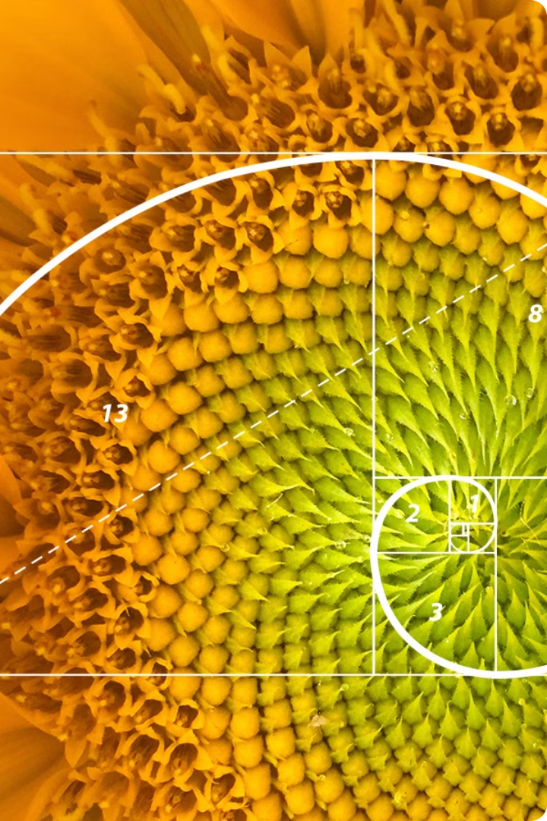

Introduction to Number Theory
Number theory is a fascinating branch of mathematics dedicated to the study of integers and their properties. It explores fundamental concepts like prime numbers, divisibility, and modular arithmetic, leading to profound insights into the structure of numbers.
by Dr. Keerthy A. S. (RCSS)

Slide 3
What are Prime Numbers?
Prime numbers are the building blocks of all integers.
They are greater than 1 and only divisible by 1 and themselves.
Examples include 2, 3, 5, 7, 11, and so on.
1
Unique Property
Key Concept
2
3
Infinite Quantity
They are the foundation of arithmetic, similar to how atoms are the building blocks of matter.
Prime numbers cannot be factored into smaller integers, making them unique and essential.
There are infinitely many prime numbers, meaning we can never list them all.

Slide 4
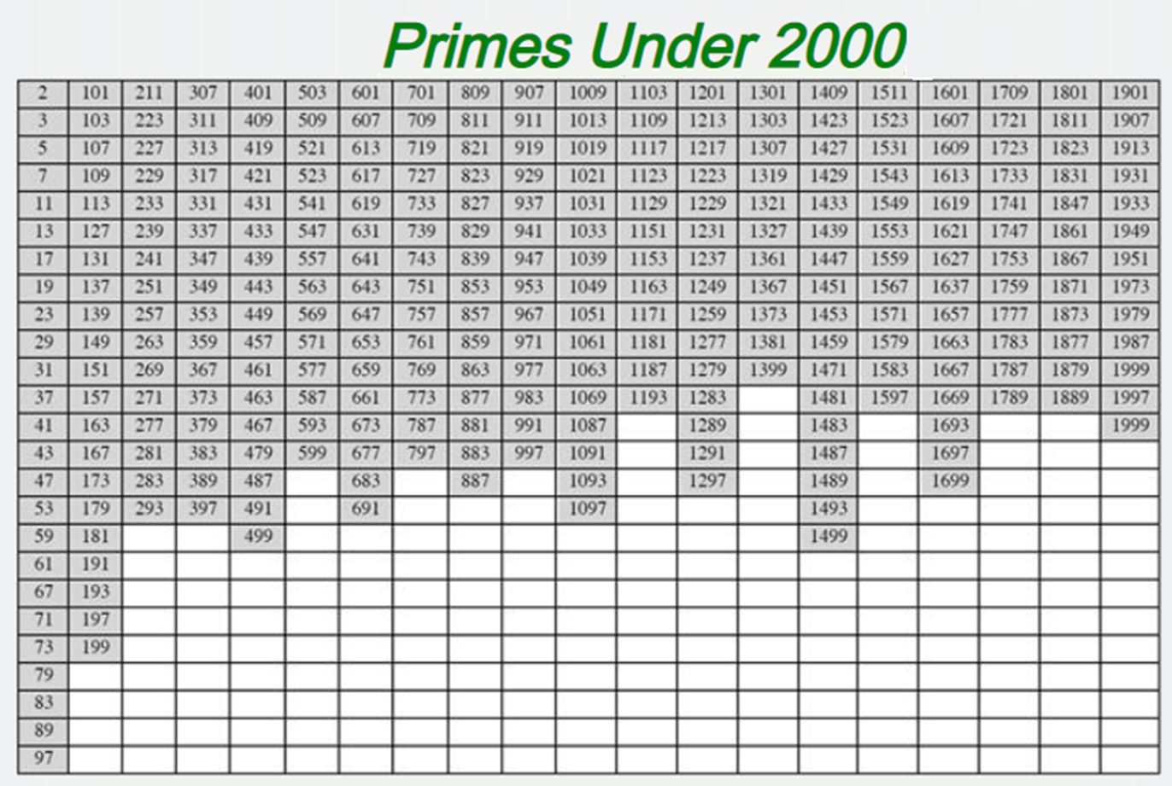
List of prime number less than 200 is:
2 3 5 7 11 13 17 19 23 29 31 37 41 43 47 53 59 61 67 71 73 79 83 89 97
101 103 107 109 113 127 131 137 139 149 151 157 163 167 173 179 181 191 193 197 199

Slide 5
Characteristics of Prime Numbers
Prime numbers possess several defining characteristics that set them apart from other integers.
Divisibility
Factorization
Distribution
Prime numbers are only divisible by 1 and themselves.
This makes them the simplest form of integers.
Every integer greater than 1 can be uniquely factored into a product of prime numbers.
This is known as the Fundamental Theorem of Arithmetic.
While the distribution of prime numbers seems random, there are patterns and theorems that govern their occurrence.

Slide 6

Importance of Prime Numbers
Prime numbers play a crucial role in various fields, from cryptography to computer science.
Cryptography
Computer Science
Number Theory Research
Prime numbers form the foundation of modern encryption methods, ensuring secure communication and data protection.
Prime numbers are used in algorithms for generating random numbers, testing for primality, and hashing data.
Prime numbers are a fundamental object of study in number theory, driving research and leading to new discoveries.

Slide 7




Practical Applications of Prime Numbers
Cryptography
Computer Science
Number Theory Research
Other Fields
Prime numbers are used in encryption algorithms to protect sensitive information, ensuring secure communication and data transmission.
Prime numbers find applications in areas like data compression, coding theory, and signal processing, highlighting their versatility.
Prime numbers are utilized in hashing functions, random number generators, and error correction codes, essential tools for computer science.
Prime numbers drive ongoing research in number theory, leading to the development of new mathematical tools and algorithms.

Slide 8
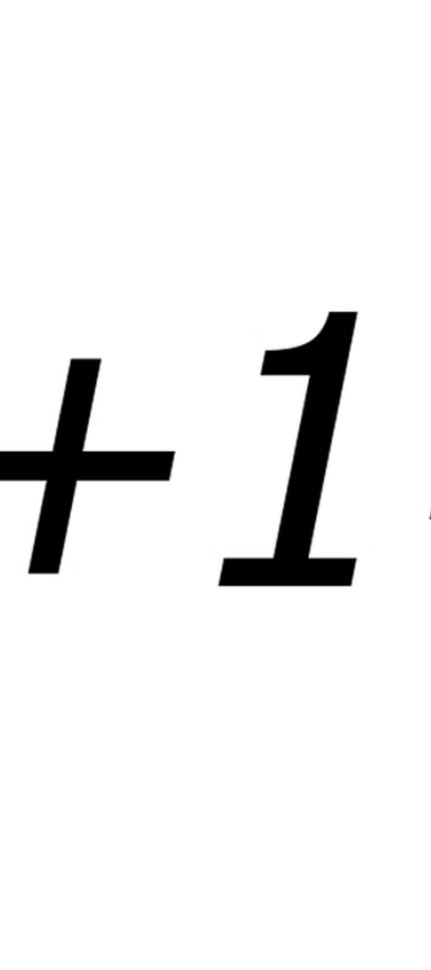
Prime Number Theorem
The Prime Number Theorem provides an estimate for the distribution of prime numbers.
1
Density
It states that the number of prime numbers less than a given number is approximately proportional to the number divided by its natural logarithm.
2
Asymptotic
This relationship is not exact but becomes increasingly accurate as the number gets larger.
3
Applications
The Prime Number Theorem has numerous applications in fields such as cryptography and theoretical computer science.

Slide 9
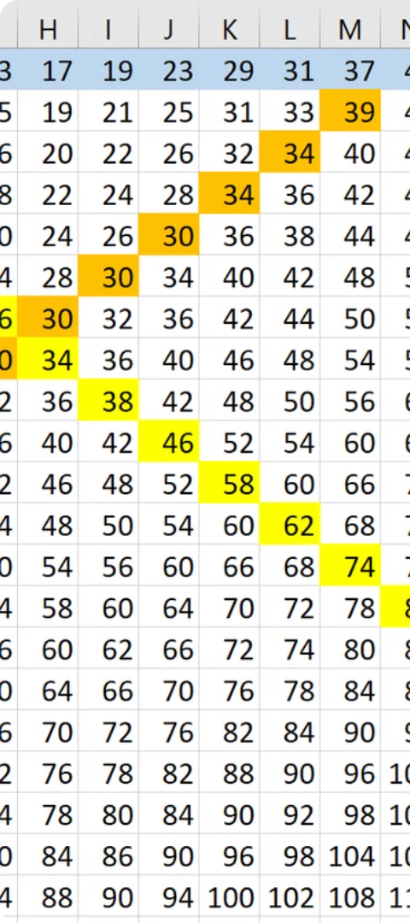
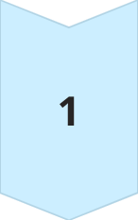
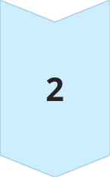
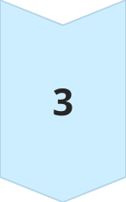
Goldbach's Conjecture
Goldbach's Conjecture is an unsolved problem in number theory.
Statement
It states that every even integer greater than 2 can be expressed as the sum of two prime numbers.
Example
For example, 4 = 2 + 2, 6 = 3 + 3, 8 = 3 + 5.
Unsolved
Despite extensive testing and numerous attempts to prove it, Goldbach's Conjecture remains unproven.

Slide 10

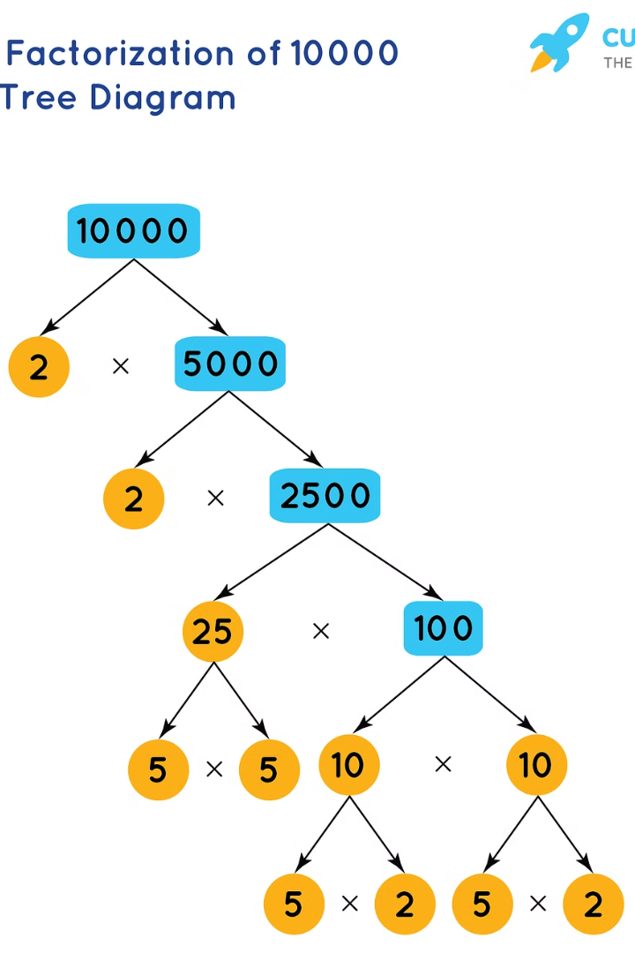
Prime Factorization
Prime factorization is the process of breaking down a number into its prime factors.
Prime numbers are the building blocks of all whole numbers.

Slide 11

Prime Factors
A prime factor is a prime number that divides another number without a remainder.
For example, the prime factors of 12 are 2 and 3, because 2 × 2 × 3 = 12.
1
Unique
2
Fundamental
3
Building Blocks
Every number greater than one has a unique prime factorization.
The prime factors are the foundation of the number, revealing its structure.
Prime numbers are like building blocks for all whole numbers, and prime factorization shows how they fit together.

Slide 12
Relatively Prime Numbers
Relatively prime numbers are two numbers that share no common factors other than 1. This means their greatest common divisor (GCD) is 1.
Example
Visual Representation
8 and 15 are relatively prime because their only common factor is 1. 8 = 2 x 2 x 2, 15 = 3 x 5.
Imagine two gears with no teeth in common, they can't mesh and move together easily.

Slide 13
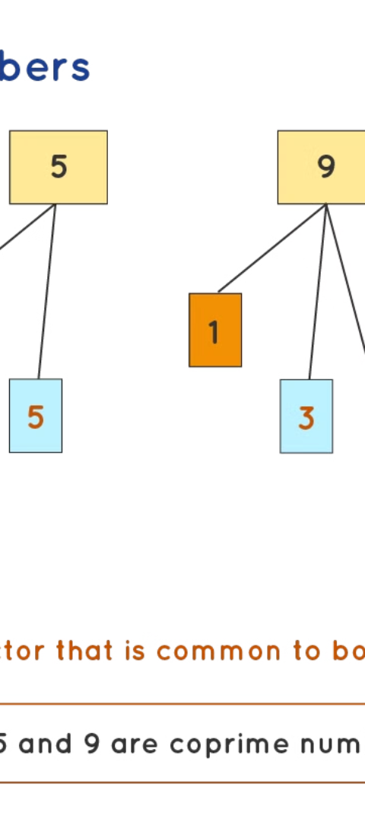
Coprime Numbers
Coprime numbers are another term for relatively prime numbers. They are numbers that have no common divisors other than 1.
Applications
Music Theory
Coprime numbers are essential in cryptography, where they are used to create secure codes.
They are also used in music theory to determine intervals and chords.
Fractions
Coprime numbers are crucial in simplifying fractions, finding the lowest common multiple, and understanding modular arithmetic.

Slide 14



Fundamental Theorem of Arithmetic
The Fundamental Theorem of Arithmetic states that every integer greater than one can be uniquely factored into a product of prime numbers, ignoring the order of the factors.
Building Blocks
Uniqueness
Foundation
Prime numbers are the fundamental building blocks of all integers.
Each integer has a unique prime factorization.
The prime factorization provides the foundation for understanding the properties of integers.

Slide 15



Applications of Prime Factorization and GCD
Prime factorization and GCD have applications in various fields, including cryptography, coding theory, and computer science.
Coding Theory
Cryptography
They are used to create error-correcting codes that can detect and correct errors in data transmission.
Prime numbers are used to create secure encryption algorithms that protect sensitive data.

Slide 16
Fermat's Little Theorem
Fermat's Little Theorem is a powerful result in number theory.
If p is a prime number and a is an integer not divisible by p, then a^{(p-1)} ≡ 1 (mod p).
Statement
Example
For p = 5 and a = 2, 2^(5-1) ≡ 1 (mod 5) since 2^4 = 16 ≡ 1 (mod 5).
Applications
Used in primality testing, cryptography, and other areas of number theory.

Slide 17
Find the remainder when 3^{100,000} is divided by 53.

Slide 18

Example:
Consider p=7
Every integer is congruent to 0, 1, 2, …6 (mod7)
Consider a = 12 , p/ a
Multiplying all non zero congruents by 12 ,
We get 12, 24, 36, 48, 60, 72 => 5,3,1,6,4,2 (mod7)
Hence multiplying the congruence class gives back the class.

Slide 19
Fermat’s Theorem: If p is prime and p|a then a^{p-1}=1(mod p) Proof: Every integer is congruent to 0,1,2,..p-1(mod p) Multiplying all non-zero residues by a, we get a, 2a, ..(p-1)a
Case 1:None is congruent to 0
If its congruent to 0 its divisible by p.
Pick r, 0<r<p
Spse, r.a= 0(modp)
p|a (given) & p|r (as r<p)
Hence none =0(mod p)
Case 2: None congruent to each other
Pick r & s , 0<r<p, 0<s<p
r.a=s.a(modp)
r.a – s.a= (r-s)a
We know p|a,
verify p|(r-s)

Slide 20
We know 0<r<p & 0<s<p
0>-s>-p => -p<-s<o
Hence, -p<r-s<p
r-s=0 as r & s are different
r-s cannot be divided by p as it falls between –p & p
Hence a, 2a, 3a, …(p-1)a modp is a rearrangement of 1, 2, 3…p-1
a.2a.3a….(p-1)a= 1.2…..(p-1)(modp)
(p-1)!a^{p-1} = (p-1)! (modp)
p|(p-1)!
Hence a^{p-1} = 1modp

